Slide 1
Mini Project - 3
Classification and Identification of Vehicles by Video Surveillance Using Machine Learning
Prepared By
Saiyam Shah ( 17bit104 )
Karan Sheth ( 17bit105 )

Slide 2
Introduction !
Notes:
In this Modern world due to the increase in the number of vehicles on the
road day by day is a very challenging task for the administration to control
and manage the traffic, Also to identify the suspect who is not following the
rules and regulation. So for that in urban areas CCTV cameras are being
installed for monitoring different events and objects taking place. This Video-
surveillance also helps to reach out to the person who does not follow traffic
rules and regulations. So for the model The same concept is applied to
Nirma University campus, Using different cameras throughout the campus at
different locations one can observe each activity of vehicles taking place.

Slide 3
Open Street Map & Sumo Simulator

Slide 4
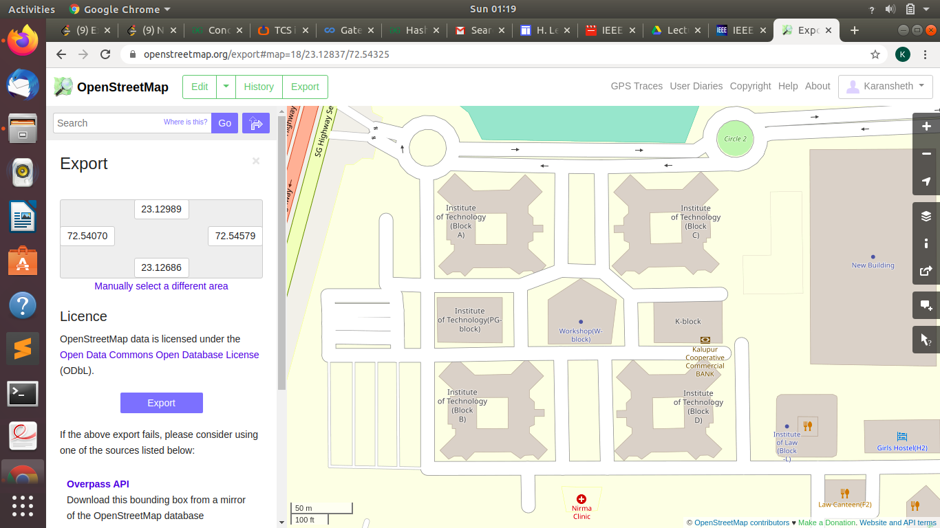

Slide 5
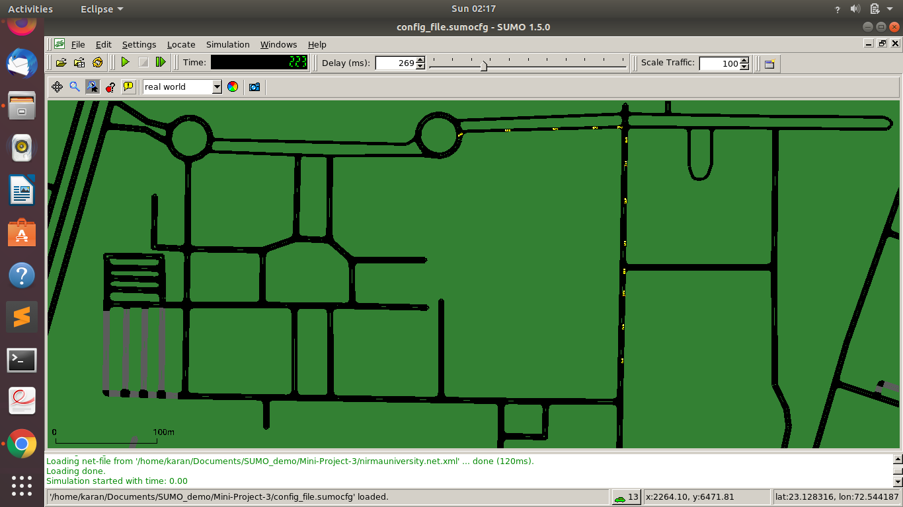
Sumo Simulator
SUMO simulator is an open source road network simulator which we used for theoretical examination of the time taken by car to travel from one point to another point on our nirma university map
This study was done to have an idea about the location of cars after some time during the case of emergency (ambulance - to save life) or during crime (to catch culprit) by understanding the traffic situation in a particular area
Notes:
we convert the .osm file into an xml file using the NETCONVERT command to make it able to run into SUMO. Then, we used the POLYCONVERT command to import shapes and then we generated random traffic using randomTrips.py file. At last, a SUMO config is create to start the simulation.

Slide 6

COLOR RECOGNITION
& IDENTIFICATION
K-Nearest Neighbours Algorithm

Slide 7
K-Nearest Neighbors
Machine Learning Classifier which is trained by R, G, B Color Histogram.
It generally classify into more different colors and other fetures like color moments correlogram,
Following are the 2 main phenomena to understand basic Object Detection/Recognition Systems of Computer Vision and Machine Learning
Feature Extraction
Classification
Notes:
It can classify and divide into different colors like White, Black, Red, Green, Blue, Orange, Yellow and Violet.

Slide 8
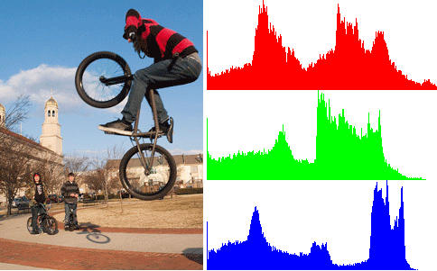
Feature Extraction
Feature Extraction = Color Histogram
It generally describes some relevant information which is present in pattern. How to represent the some interesting points we found to compare them with other interesting points (features) in the image.
Notes:
Color Histogram is a representation of the distribution of colors in an image. For digital images, it will represent the total number of pixels having fixed range of colors whether they belong to R, G, B segment or any combination of it, that span the image's color space, the set of all possible colors.

Slide 9
Classification
A simple as well as supervised learning algorithm
It assumes that all the similar or same things are near to each other or related to each other. For eg: “Birds of a feather flock together.”
The only disadvantage of this algorithm is it gets much slower with the increase in the number of independent variables.
Notes:
K nearest neighbors is a simple as well as supervised learning algorithm that stores all available cases and classifies new cases based on a similarity measure (e.g., distance functions).

Slide 10
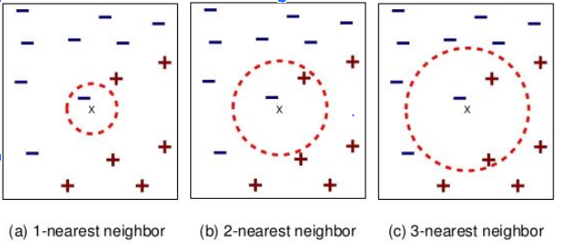
Continue...

Slide 11
Object Counting Using Mask R-CNN
The method, called Mask R-CNN, extends Faster R-CNN by adding a branch for predicting an object mask in parallel with the existing branch for bounding box recognition
Mask R-CNN is simple to train and adds only a small overhead to Faster R-CNN, running at 5 fps.
Mask R-CNN is easy to generalize to other tasks
Notes:
It is a kind of the separator es and masks.which generally separates the images as well as videos and outputs it in the form of bounding box,class
For eg : e.g., allowing us to estimate human poses in the same framework.

Slide 12
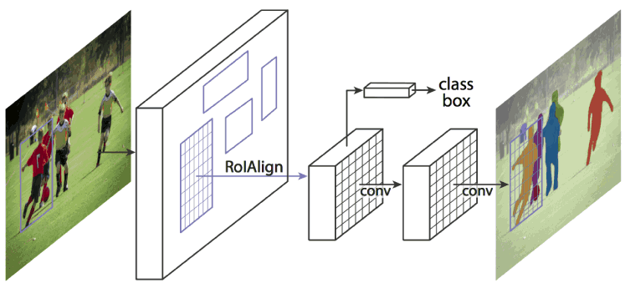
Architecture of Mask RCNN structure

Slide 13
Object Detection and Classification

Slide 14
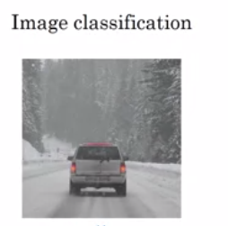
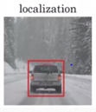
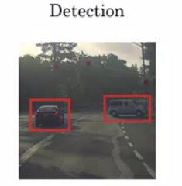
Objectives
Localization
Detection
Classification

Slide 15
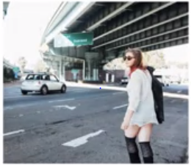
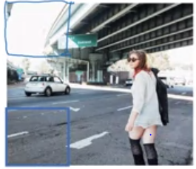
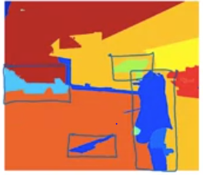
Region -CNN

Slide 16
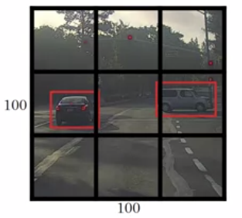
Bounding Box Detection Algorithm
Notes:
So notice two things, first, this is a lot like the image classification and localization algorithm . And that it outputs the bounding balls coordinates explicitly. And so this allows in your network to output bounding boxes of any aspect ratio, as well as, output much more precise coordinates that aren't just dictated by the stripe size of your sliding windows classifier.
And second, this is a convolutional implementation and you're not implementing this algorithm nine times on the 3 by 3 grid or if you're using a 19 by 19 grid.19 squared is 361.
Instead, this is one single convolutional implantation, where you use one consonant with a lot of shared computation between all the computations needed for all of your 3 by 3 grid cells.

Slide 17
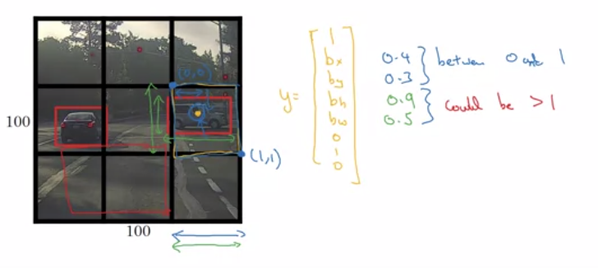
Specifying Bounding Box

Slide 18
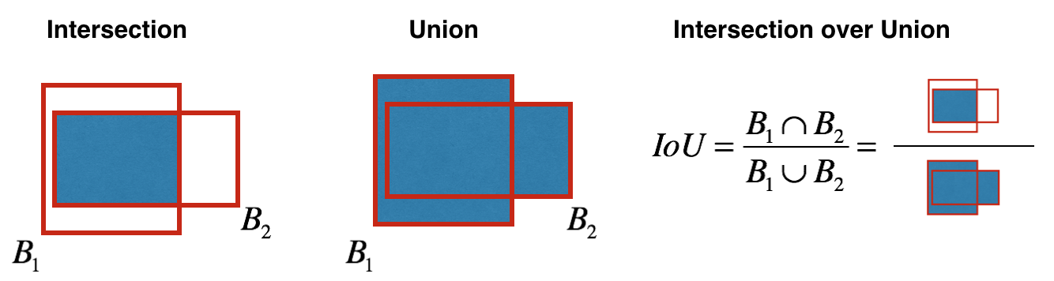
Intersection Over Union
A function helps to use for evaluating your object detection algorithm.
Correct if IOU >= 0.5.
More Generally, IoU is a measure of the overlap between two bounding boxes

Slide 19
Non Max Suppression
find multiple detections of the same objects. Rather than detecting an object just once, it might detect it multiple time
Notes:
To do so, you'll use non-max suppression. Specifically, you'll carry out these steps:
Get rid of boxes with a low score (meaning, the box is not very confident about detecting a class; either due to the low probability of any object, or low probability of this particular class).
Select only one box when several boxes overlap with each other and detect the same object

Slide 20
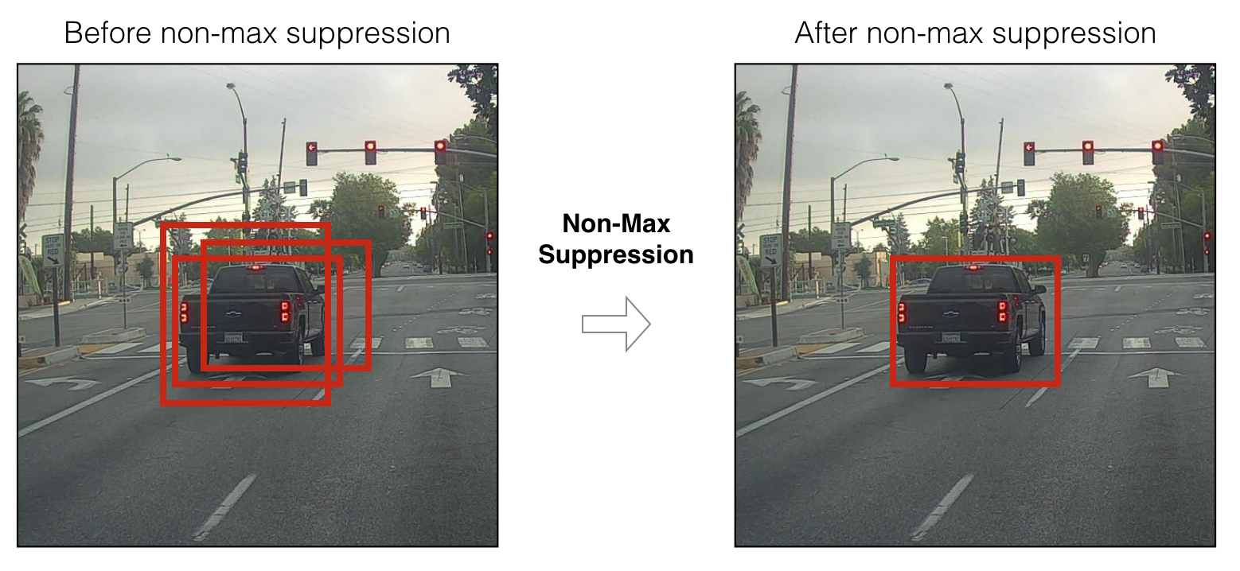
Notes:
Even after filtering by thresholding over the class scores, you still end up with a lot of overlapping boxes. A second filter for selecting the right boxes is called non-maximum suppression (NMS).
In this example, the model has predicted 3 cars, but it's actually 3 predictions of the same car. Running non-max suppression (NMS) will select only the most accurate (highest probability) of the 3 boxes.

Slide 21
Anchor Boxes
One of the problems with object detection as you have seen it so far is that each of the grid cells can detect only one object.
What if a grid cell wants to detect multiple objects? Here is what you can do. You can use the idea of anchor boxes.

Slide 22
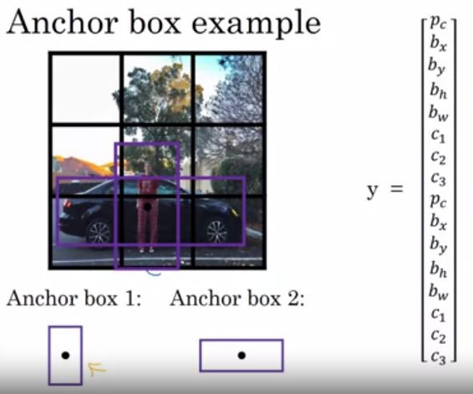
Notes:
The test image is first broken up into a grid and the network then produces output vectors, one for each grid cell. These vectors tell us if a cell has an object in it, what class the object is, and the bounding boxes for the object. Since we’re using two anchor boxes, we’ll get two predicted anchor boxes for each grid cell. Some, in fact most of the predicted anchor boxes will have a very low PC(Probability of object being present in it) value.
After producing these output vectors, we use non-maximal suppression to get rid of unlikely bounding boxes. For each class, non-maximal suppression gets rid of the bounding boxes that have a PC value lower than some given threshold

Slide 23
Algorithm
Previously
each object in the training set and the training set image, it was assigned to the grid cell that corresponds to that object's midpoint.
After Anchor Box
each object is assigned to the same grid cell as before, assigned to the grid cell that contains the object's midpoint, but it is assigned to a grid cell and anchor box with the highest IoU with the object's shape.
Notes:
In particular, if your data set has some tall, skinny objects like pedestrians, and some white objects like cars, then this allows your learning algorithm to specialize so that some of the outputs can specialize in detecting white, fat objects like cars, and some of the output units can specialize in detecting tall, skinny objects like pedestrians

Slide 24
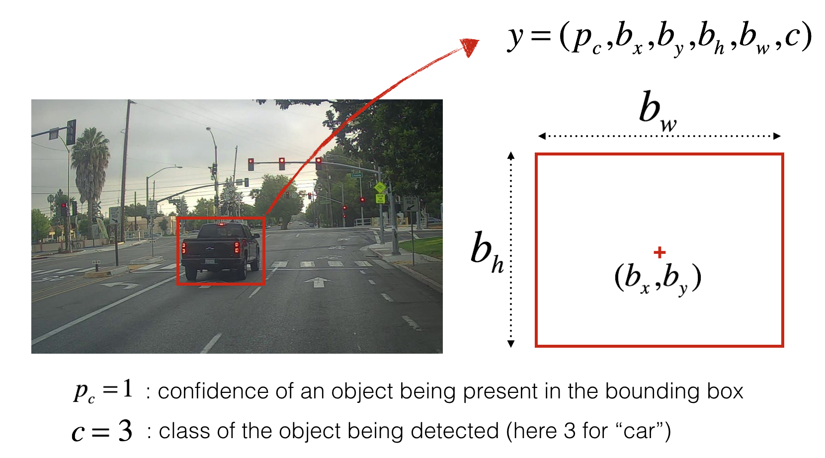
If you have 80 classes that you want the object detector to recognize, you can represent the class label c either as an integer r from 1 to 80, or as an 80-dimensional vector (with 80 numbers) one component of which is 1 and the rest of which are 0.

Slide 25
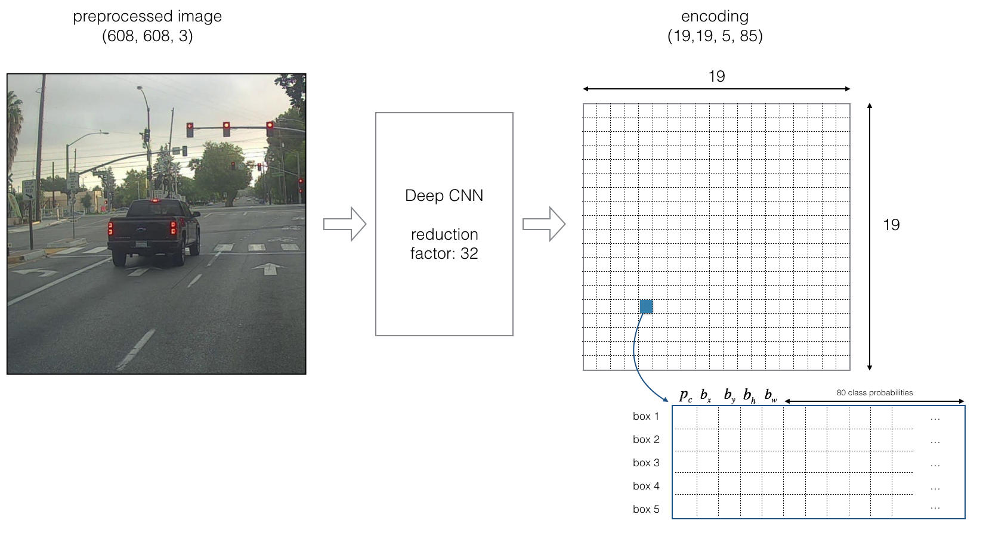
If the center/midpoint of an object falls into a grid cell, that grid cell is responsible for detecting that object

Slide 26
References
Redmon, J. and Farhadi, A., 1804. YOLOv3: an incremental improvement (2018). arXiv preprint arXiv:1804.02767.
X. Liang, Y. Wei, X. Shen, J. Yang, L. Lin, and S. Yan, “Proposal-free network for instance-level object segmentation,” arXiv preprint arXiv:1509.02636, 2015.
Redmon, J., Divvala, S., Girshick, R. and Farhadi, A., 2016. You only look once: Unified, real-time object detection. In Proceedings of the IEEE conference on computer vision and pattern recognition (pp. 779-788).

Slide 27
Conclusion
In this approach distributed camera networks were employed in our detecting areas for the recognition of vehicles.
Practical results also show the identification of vehicles in which the project restricted for one car and 2 cameras are considered, the one at front gate of the Institution and other at the parking area.

